Slide 1
Lecture # 1
CSC336 Web Technologies
Credit Hours: 3(2, 1)
Course Instructor: Yasmeen Jana
Lecturer CS Dept, CUI Vehari
MSCS COMSATS University Islamabad, Vehari
MCS COMSATS University Islamabad, Vehari

Slide 2
Overview of Web Platforms

Slide 3

Agenda
Overview of Web Terminologies
Web Communication Protocol (HTTP)
Web Generations
Standards & Constraints

Slide 4
Introduction to Web Platforms
Definition of Web Platforms
“Web platforms are digital environments or frameworks that allow users
to interact with, develop, and deploy web-based applications and services.”
Importance in Modern Technology
They provide a structured way for developers to create, manage, and deliver
content and functionality over the internet

Slide 5
Key components
Web platforms can vary in complexity and scope, but they typically include several key components:
Infrastructure: The underlying technology stack, including servers, databases, and network resources that support web applications.
Development Tools: Software and frameworks that aid in building web applications. This includes languages (like HTML, CSS, JavaScript), libraries, and frameworks (such as React, Angular, or Django).
Content Management: Systems or tools that help manage, organize, and deliver content. Examples include WordPress, Drupal, and Joomla.
User Interface (UI): The elements and design that users interact with directly, such as web
pages, forms, and navigation menus.
Application Programming Interfaces (APIs): Interfaces that allow different software systems to communicate and interact with each other. APIs are crucial for integrating third-party services and enabling complex functionalities.
Security Features: Measures and protocols to protect data and ensure secure interactions between users and the platform. This includes authentication, encryption, and access controls.

Slide 6
Examples of web platforms
Social Media Platforms: Facebook, Twitter, Instagram, which allow users to create and share content.
E-commerce Platforms: Shopify, Magento, WooCommerce, which enable businesses to sell products and services online.
Content Management Systems (CMS): WordPress, Drupal, Joomla, which help users create and manage website content without deep technical knowledge.
Cloud Platforms: Amazon Web Services (AWS), Google Cloud Platform (GCP), Microsoft Azure, which provide infrastructure and services for building and hosting web applications.

Slide 7
Web Communication Protocol - HTTP
Definition of HTTP
HTTP, or Hypertext Transfer Protocol, is a foundational protocol used for transmitting data over the web.
HTTP is the protocol used for transferring hypertext (text with links) and other resources between a web server and a web client (such as a browser).
Role in Web Communication
It defines how messages are formatted and transmitted, and how web servers and
browsers should respond to various commands.

Slide 8
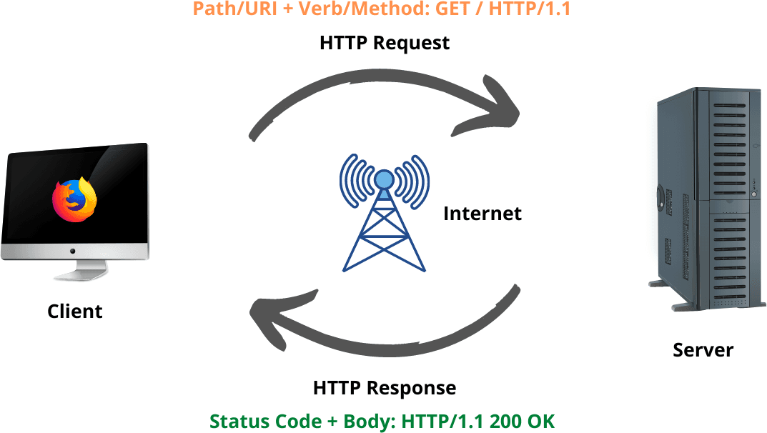
HTTP - Request and Response Cycle
HTTP operates on a request- response model:
Client (Browser) requests
content from Server
Server sends the requested content back to the Client in the form of Response

Slide 9

HTTP Methods
GET
Retrieve data from the server (e.g., requesting a web page).
POST
Submit data to be processed by the server (e.g., submitting a form).
PUT/PATCH
Updates existing data on the server.
DELETE
Deletes data from the server.

Slide 10
HTTP Status Codes
1xx
Informational Responses
2xx
Success Responses (e.g., 200 OK)
3xx
Redirection Responses
4xx
Client Error Responses (e.g., 404 Not Found)
5xx
Server Error Responses (e.g., 500 Internal Server Error)

Slide 11
HTTP Headers
HTTP messages include headers that provide additional information about the request or response. For instance:
‘Content-Type’ specifies the type of data being sent
‘Authorization’ includes credentials for accessing protected resources.

Slide 12
HTTPS - Secure Communication
HTTPS
HTTP Secure
SSL/TLS(Secure Sockets Layer / Transport Layer Security)
Encrypts communication between client and server
Importance of Security
HTTPS (Hypertext Transfer Protocol Secure) is an extension of HTTP that uses encryption (via SSL/TLS) to secure the data transmitted between the client and server, protecting it from eavesdropping and tampering.

Slide 13


Web Generations - Overview
1
Web 1.0
The Static Web
2
Web 2.0
The Social Web
3
Web 3.0
The Semantic Web

Slide 14
Web 1.0 - The Static Web
Like a digital newspaper – you can read but not interact.
Timeframe
1990s
Characteristics
Static pages, limited interactivity
Examples
Early websites with basic HTML

Slide 15


Web 2.0 - The Social Web
Like a conversation – you can interact, comment, and engage
Timeframe
2000s
Characteristics
Dynamic content, user-generated content, social media
Examples
Facebook, Twitter, YouTube

Slide 16
Web 3.0 - The Semantic Web
Like a smart assistant – understands and adapts to user needs.
Timeframe
2010s onwards
Characteristics
Machine-readable content, AI- driven, personalized experiences
Examples
Google’s Knowledge Graph, Voice
Assistants

Slide 17

Web 4.0 - The Intelligent Web (Future)
Characteristics
Advanced AI, IoT integration, immersive experiences
Predicted Evolution
Potential Impact
Revolutionize user experience with advanced AI-driven personalization, seamless integration of physical and digital worlds.

Slide 18
Web Standards - Introduction
Definition of Web Standards
Web standards are guidelines and specifications established by organizations such as the World Wide Web Consortium (W3C) and the Internet Engineering Task Force (IETF) to ensure consistent, interoperable, and accessible web content and technologies across different devices and platforms.
Importance in Web Development
Web standards are crucial in web development for ensuring:
Compatibility
Accessibility
Consistency
across diverse browsers and devices, leading to a more reliable and user-friendly web experience.

Slide 19

Key Web Standards Organizations
W3C
World Wide Web Consortium
IETF
Internet Engineering Task Force
WHATWG
Web Hypertext Application Technology Working Group

Slide 20

HTML & CSS Standards
HTML5
Latest version, features, and importance
CSS3
Latest version, new features (flexbox, grid)

Slide 21
JavaScript Standards [ECMAScript(ES)]
Evolution of JavaScript
Old ECMAScript versions was named by numbers: ES5 and ES6.
From 2016, versions are named by year: ES2016, 2018, 2020.
The 15th edition, ECMAScript 2024, is published in July 2024.
ECMAScript 2024
Key Features
Current Standard
Asynchronous programming, modules, etc.

Slide 22
Web Accessibility Standards
WCAG
Web Content Accessibility Guidelines
Importance of Accessible Web Design
Accessible web design is essential for ensuring that all users, including those with disabilities, can effectively interact with and navigate websites, promoting inclusivity and equal access to information.
Examples
Text-to-speech, keyboard navigation

Slide 23
Importance of Speed and Performance
Web Performance Standards
Standards
Page load time, mobile responsiveness
Tools
Google Lighthouse, WebPageTest

Slide 24


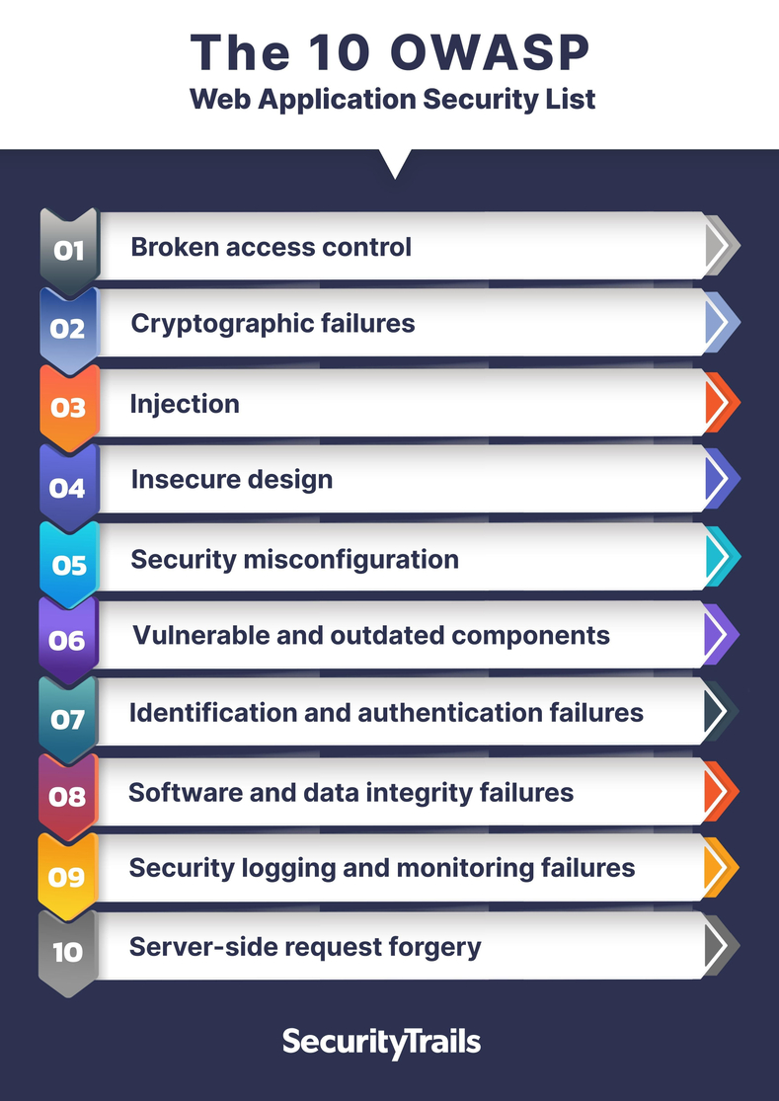
Web Security Standards
Best Practices
Secure coding, data encryption, authentication
Common Standards
OWASP(Open Web Application Security Project) Top Ten

Slide 25
Web Constraints - Introduction
Definition of Constraints in Web Development
In web development, constraints refer to limitations or restrictions imposed on design, functionality, or technology, such as browser compatibility, performance requirements, and accessibility standards, that guide the development process and influence how web applications are built and optimized.
Importance of Understanding Constraints
Understanding constraints is vital for web development as it ensures the creation of functional, performant, and compatible web solutions within defined limitations and requirements.

Slide 26
Technical Constraints
Browser Compatibility
Ensuring consistent experiences across browsers
Device Compatibility
Adapting to different screen sizes and devices
Bandwidth Limitations
Optimizing for low-bandwidth connections

Slide 27

Legal and Ethical Constraints
Data Privacy Laws
GDPR, CCPA
Intellectual Property
Copyright, patents in web development
Ethical Considerations
Ensuring fair use, avoiding dark patterns

Slide 28
User Experience (UX)
Designing with the user in mind
Accessibility
Meeting standards for disabled users
Consistency
Ensuring a uniform design language across platforms
Design Constraints

Slide 29
Content Constraints
Localization
Adapting content for different languages and cultures
SEO
Search Engine Optimization best practices
Content Load
Managing large multimedia files and dynamic content

Slide 30
Balancing Standards & Constraints
Importance of Maintaining Balance
Practical Approaches
Examples of Successful Web Platforms

Slide 31
Examples of Successful Web Platform
Examples of successful web platforms include:
Amazon: Dominates e-commerce with a vast product range, personalized recommendations, and robust logistics.
Facebook: Connects billions of users through social networking, messaging, and content sharing.
WordPress: Powers a significant portion of websites with its flexible content management system and extensive plugin ecosystem.
Netflix: Delivers on-demand video streaming with personalized content recommendations and a user-friendly interface.
Shopify: Enables businesses of all sizes to set up and manage online stores with ease.

